Slide 1
Predicting Best venue for Warehouse Store
(Etobicoke)
~By Praveen Kumar

Slide 2

Predicting Venue for Warehouse Establishment is valuable
Mostly Earning depends on the regular customers.
So we try our best to find best location where most customers are situated.
Customers should be regular.
Venue with More number of customers are given first priority.
All Contractor of serving those customers are interested in benefits.
Predicting best venue will help Contractor of warehouse team very much

Slide 3
Data acquisition and cleaning
Firstly Data of Toronto city is scraped by the wikipedia page using given link : Toronto Data from wikipedia.
We are interested in latitude and longitude for each Borough in Toronto. It is extracted from link Latitudes and Longitudes.
All Duplicates are removed from the raw data and ultimately converted into python pandas DataFrame.
Finally we join latitudes and longitudes to original Data “.csv” file.

Slide 4
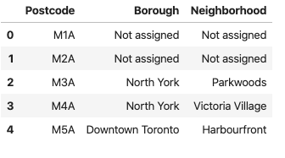
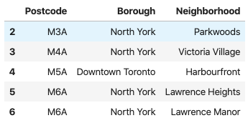
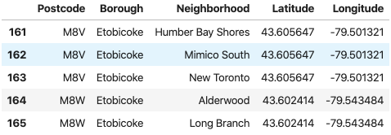
Improvement in data Extraction
Fig: Showing rew_Data
Fig:Dropping unused Data
Fig:showing data after adding latitudes and longitudes

Slide 5
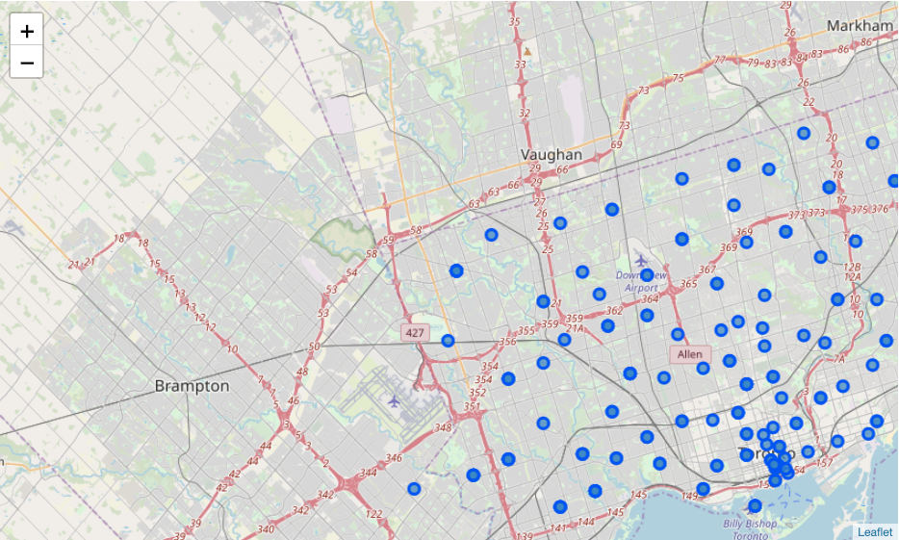
Map of Toronto

Slide 6
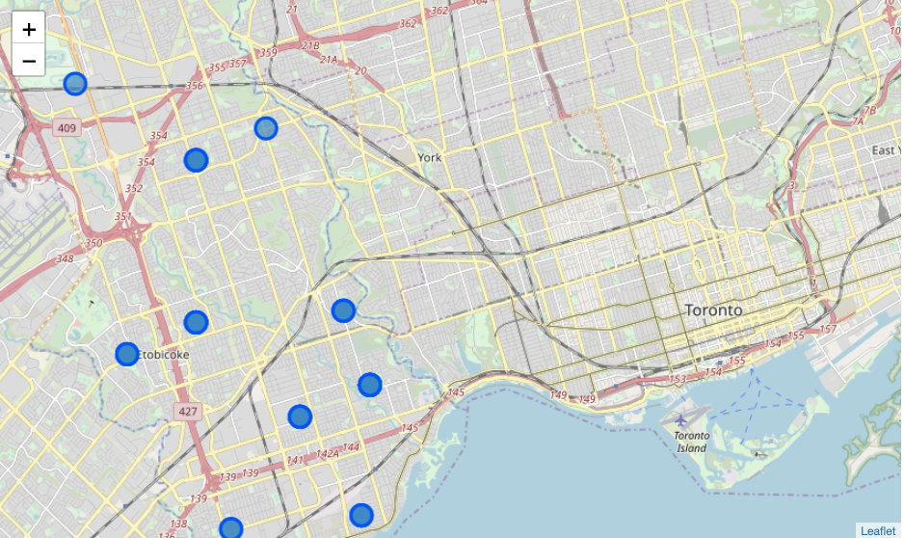
The geograpical coordinate of "Etobicoke" (43.605647, -79.501321)
[18]:

Slide 7
Methodology And Analyzing
After finding the list of neighborhoods, we then connect to the Foursquare API to gather information about venues inside each and every neighborhood. For each neighborhood, we have chosen the radius to be 750 meter. It means that we have asked Foursquare to find venues that are at most 750 meter far from the center of the neighborhood.

Slide 8
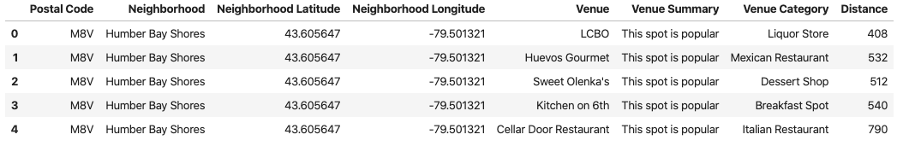
Processing the Retrieved Data and Creating a DataFrome for All the Venues inside the Etobicoke

Slide 9
Processing the Retrieved Data and Creating a DataFrome for All the Venues inside the Scarborough
When the data is completely gathered, we will perform processing on that raw data to find our desirable features for each venue. Our main feature is the category of that venue. After this stage, the column "Venue's Category" wil be One-hot encoded and different venues will have different feature-columns. After On-hot encoding we will integrate all restaurant and shopping centres columns to one column.

Slide 10
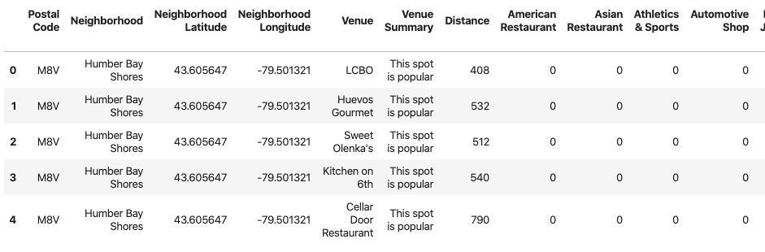

Slide 11
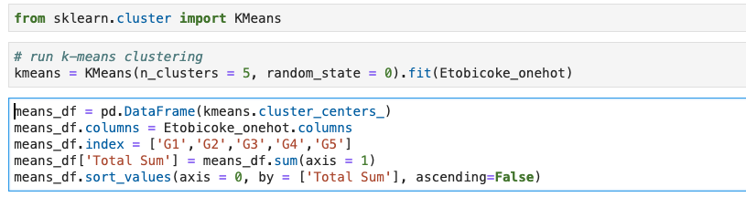
Applying one of Machine Learning Techniques (K-Means Clustering)

Slide 12
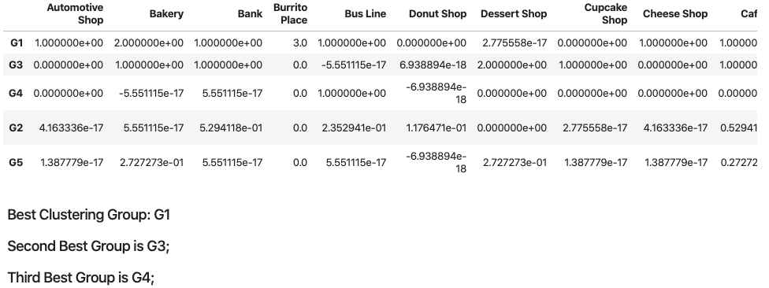
Best topmost Venue Custer group

Slide 13
Results and Discussion
Our analysis shows that although there is a great number of neighbours in Etobicoke Toronto. , there are pockets of low shopping centres and restaurant density fairly close to city center.o we focused our attention to these areas , corresponding to boroughs Etobicoke. So our attention was focused onthese centres which are more closeness to Warehouse center, strong economic point view.
Result of all this is 11 venues location containing largest number of potential for WArehouse's locations based on number of and distance to existing venues - both restaurants in general and all restaurants particularly.It is entirely possible that there is a very good reason for small number of Warehouse in any of those areas, reasons which would make them unsuitable for a new warehouses regardless of lack of competition in the area.

Slide 14
Conclusion
Purpose of this project was to identify Etobicoke Toronto areas close to centre with higher number of shopping centres and restaurants in order to aid stakeholders for optimal location for a new Warehouse Centres. By calculating density of any types of shops and restaurant distribution from Foursquare data we have first identified general neighbourhoods of borough Etobicoke. Clustering of those locations was then performed in order to create major zones of interest (containing greatest number of potential locations) and addresses of those zone centers were created to be used as starting points for final exploration by stakeholders.
Final decision on optimal Warehouse location will be made by stakeholders based on specific characteristics of neighborhoods and locations in every recommended zone, taking into consideration additional factors like attractiveness of each location (proximity to park or water), levels of noise / proximity to major roads, real estate availability, prices, social and economic dynamics of every neighborhood etc.

Slide 15
“Thank You”
(^_^)

